Slide 1
Sample Presentation
On a big screen, it’s like the words are floating because black = blank

Slide 2
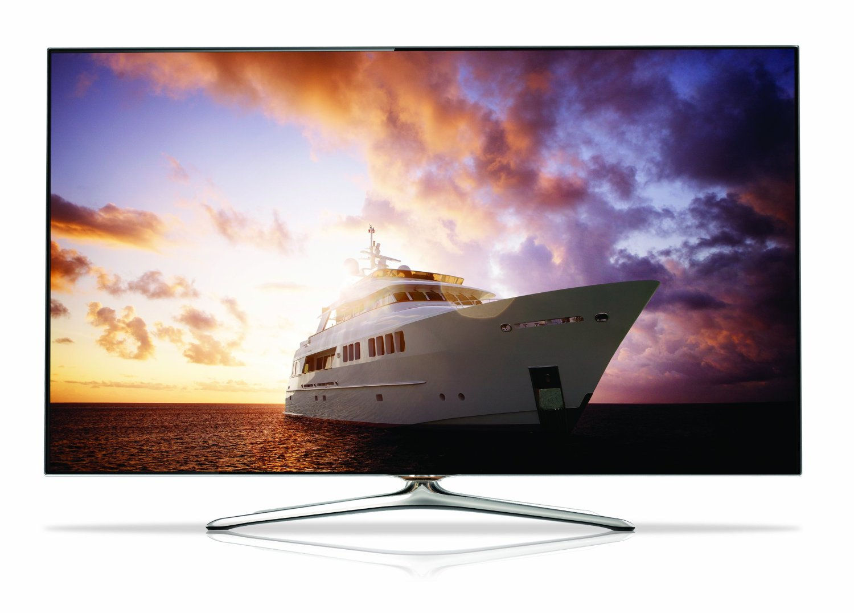
In an HD world, we need wide screen slides

Slide 3
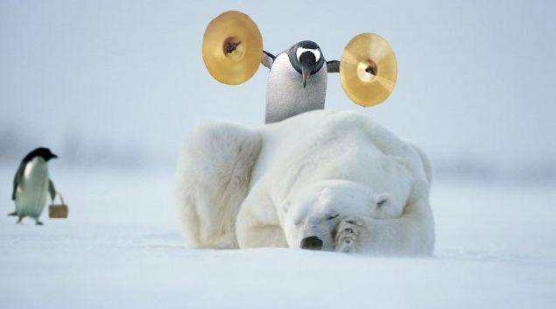
Are you brave enough to use just a blank slide?

Slide 5
My Main Points
My Point #1, with some boring supporting text that I feel compelled to read.
My Point #2, more light reading to help folks sleep.
My Point #3, which I’ll skip over because I’m running out of time

Slide 6
My Point #1

Slide 7
My Point #2

Slide 8
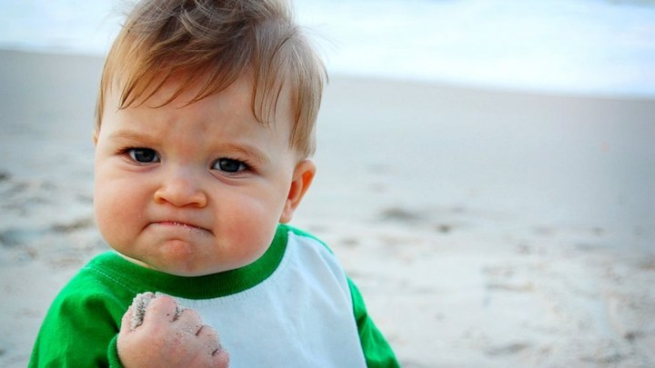
My Point #3

